Slide 1
Library Reorganization
an action research project
By Carol Wellen
RSM 541

Slide 2
Our Problem
Students and teachers do not have the knowledge or understanding of the library organizational system to access the books and information that they need.

Slide 3
Research Questions
How will reorganizing the library affect students’ and teachers’ ability to find resources?
What affect will instructional lessons, videos, and signage have on students searching independently versus immediately asking for help?
How will circulation statistics change as a result of the reorganization?

Slide 4
A little background…

Slide 5
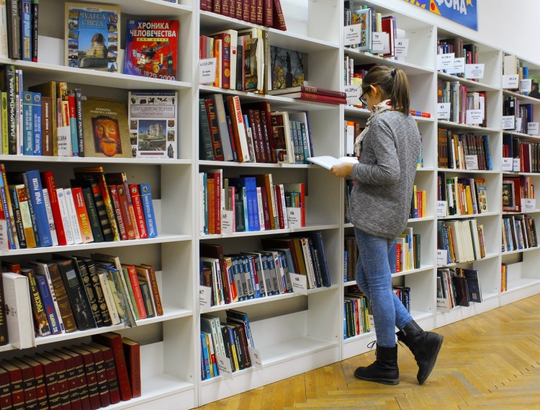
What we hope to achieve
After reorganizing the library by genre…
Students and teachers will find resources they want using the new categories
Students will select and find books independently
Resources will be better organized so time to find books will decrease
Overall circulation and books read will increase

Slide 6
What others have found
“Since genrefying the library we have seen a dramatic increase in students wanting to check out books. I believe organizing by genres gives students some focus in the library in terms of how to find the genre they are interested in. Providing this focus has increased the number of students with books in their hands reading outside of school.” - T. J. Jarchow, principal of Wedgewood MS
“Regrouping my collection has been invaluable. Now there's a large contingent of "nonreaders" who stop by the library to find "their" kind of books. Students rushing between classes can quickly find their favorite genre or one that they need for an assignment.” – Laura Stiles, librarian at Cedar Valley MS
“After genrefying, students take more responsibility with their book selection.” – Jen Siderius, librarian at New Market ES

Slide 7
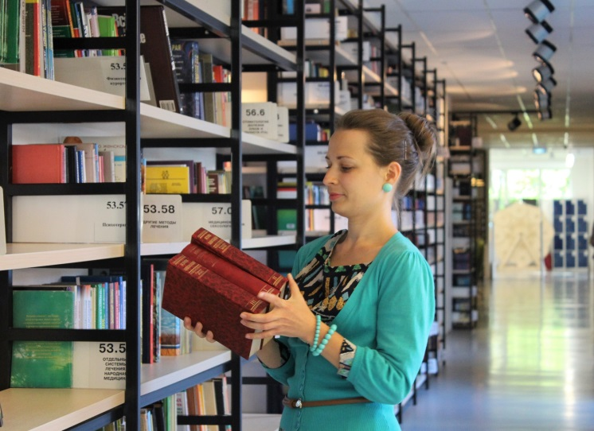
Actions to be taken
Reorganize the collection by genres/topics so that it makes more sense
Label all resources uniformly so that they are shelved correctly
Teach how the resources are organized
Teach how to find resources, using signage and the OPAC
Create instructional videos
Make adequate signs for resources

Slide 8
Action plan

Slide 9
Data collection
Sample size:
With less than 300 students and only 22 classroom teachers, sample sizes may present a challenge.
To have 95% confidence in the survey results,
I would need to survey 164 out of 285 students.
If I survey teachers, I would need to survey 21 out of 22 teachers to have the same level of confidence.
Data collection tools I will be using are surveys, interviews, and archival data.

Slide 10
Sample survey

Slide 11
Sample interview
Do you have specific books in mind when you come to the library, or do you search by a particular topic or theme?
How often do you feel that you are able to find what you need in the library?
Do you think it is easier, about the same, or more difficult to find the books you need with the new library organization?
What suggestions do you have for ways we can continue to improve the library?

Slide 12
Sample circulation data
Row Labels | Sum of Circs this Period | Percentage of Circulation 2016-2017 | Collection Percentage
E | 2831 | 21.1% | 23.5%
EBK | 0 | 0.0% | 1.7%
FIC | 2908 | 21.6% | 17.6%
GRN | 1100 | 8.2% | 1.5%
KIT | 0 | 0.0% | 0.2%
MAG | 42 | 0.3% | 0.1%
NF
000s | 233 | 1.7% | 0.6%
100s | 262 | 1.9% | 0.6%
200s | 14 | 0.1% | 0.4%
300s | 501 | 3.7% | 8.1%
400s | 28 | 0.2% | 0.6%
500s | 1662 | 12.4% | 16.4%
600s | 1948 | 14.5% | 7.2%
700s | 1126 | 8.4% | 6.7%
800s | 123 | 0.9% | 2.5%
900s | 287 | 2.1% | 5.7%
BIO | 362 | 2.7% | 4.7%
PRO | 0 | 0.0% | 0.5%
REF | 18 | 0.1% | 1.3%
SC | 1 | 0.0% | 0.1%
VID | 0 | 0.0% | 0.2%
Grand Total | 13446 | 100.0% | 100.0%

Slide 13
Reporting the findings
Findings will include survey results, student and teacher feedback, and circulation statistics.
A high level description of survey results and feedback will be shared with students on the morning announcements.
A one page pamphlet of findings will be shared with teachers and staff at the monthly staff meeting.
Survey results and circulation statistics can be shared with parents in the monthly Liberty newsletter.
The complete action research report will be shared with the administration.

Slide 14
Conclusion
Currently, students have difficulty finding resources they need in our library.
Reading is essential for students to improve their reading proficiency. Students who cannot find books of interest are more likely to get frustrated and less likely to read.
Research has shown that organizing a library by genre allows students to find books easier.
Organizing the library collection by genre will allow students at our school to find books easier and read more books of interest to them.
Helping students become independent and successful in looking for reading materials is the key to maintaining their interest in reading.

Slide 15
Works Cited
Howard, Jody K., and Su A. Eckhardt. Action Research: A Guide for Library Media Specialists. Linworth, 2005.
Moreillon, Judi. "One Common Challenge- Two Different Solutions." Knowledge Quest 42.2 (2013):
38-43. ProQuest. http://hoover2.mcdaniel.edu:2075/education/docview/1460536248/7967D7E3A8134A8FPQ/2?accountid=12333. Accessed 4 Apr. 2017.
Sagor, Richard D., and Charlene Williams. The Action Research Guidebook. 3rd ed., Corwin, 2017.
Stiles, Laura. "Shelf Shifters: Thanks to a New Fiction Section, a Quiet Library Now Has a Booming
Business." School Library Journal, vol. 50, no. 9, 01 Sept. 2004, p. 32. EBSCOhost, hoover2.mcdaniel.edu:2443/login?url=http://search.ebscohost.com/login.aspx?direct=true&db=eric&AN=EJ706113&site=ehost-live. Accessed 4 Apr. 2017.
Sweeney, Stephanie. "Genrefy Your Library: Improve Readers' Advisory and Data-Driven Decision
Making." Young Adult Library Services, vol. 11, no. 4, Summer 2013, pp. 41-45. EBSCOhost, hoover2.mcdaniel.edu:2443/login?url=http://search.ebscohost.com/login.aspx?direct=true&db=a9h&AN=89132689&site=ehost-live. Accessed 4 Apr. 2017.
Wellen, Carol. “Interview.” 20 March 2017.
All images were found on Pixabay (pixabay.com) and are in the public domain.

Slide 16
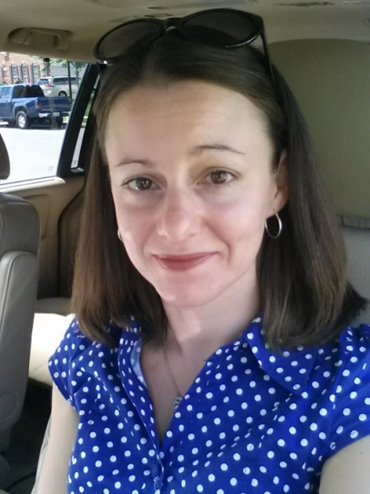
This Voicethread is licensed under a Creative Commons Attribution-ShareAlike 4.0 International License.
About the Author, Carol Wellen
I am a teacher in Frederick, MD and a graduate student at McDaniel College.
You can follow me on Twitter @CarolLWellen.

