Slide 1
Technology in the Classroom: Using blogs and wikis with your students
Carol Wellen
SLM 508

Slide 3
Some ways blogs can be used:
a journal for reading responses in language arts
a place for students to reflect on what they have read or learned
a way to encourage discussion among students about a particular topic or book
an online portfolio of student writings throughout the year

Slide 4
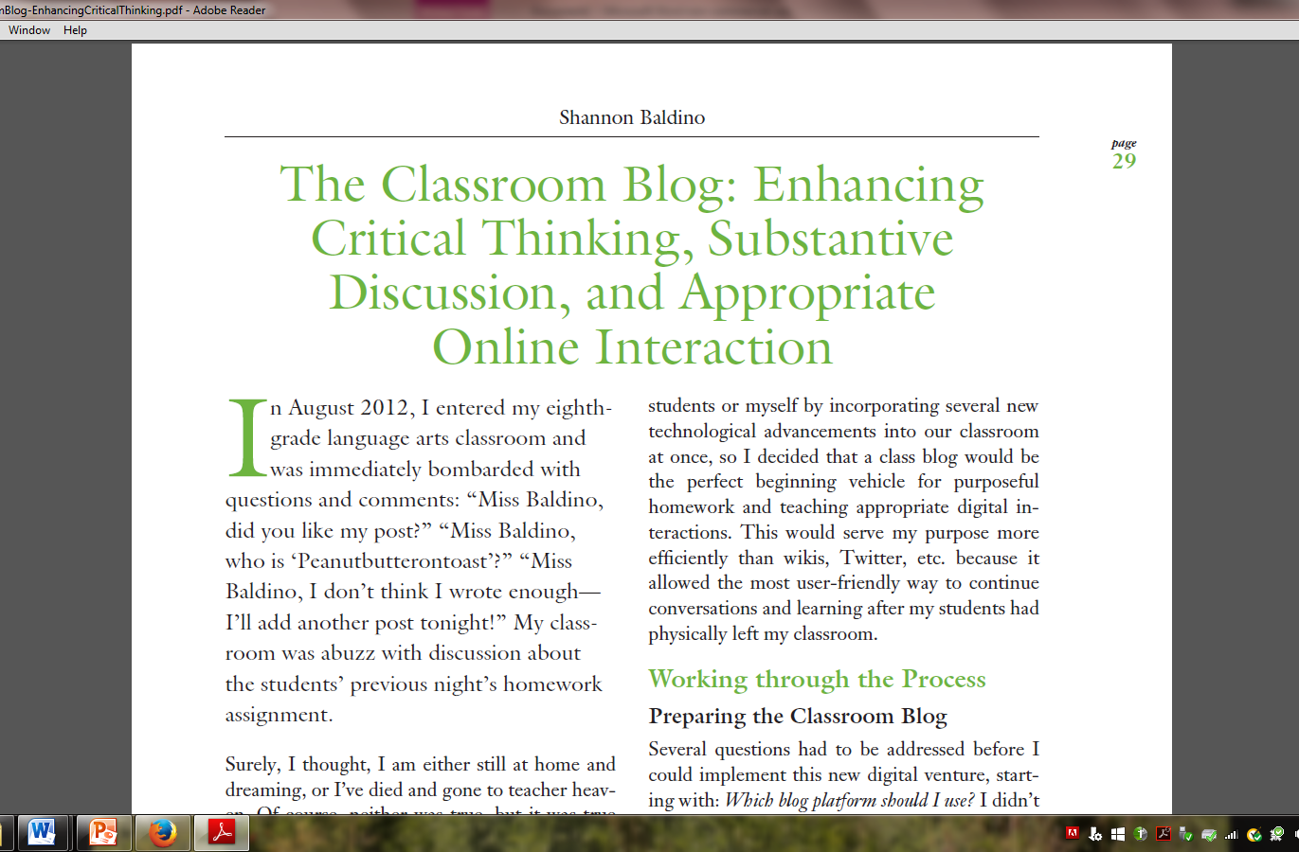

Slide 5
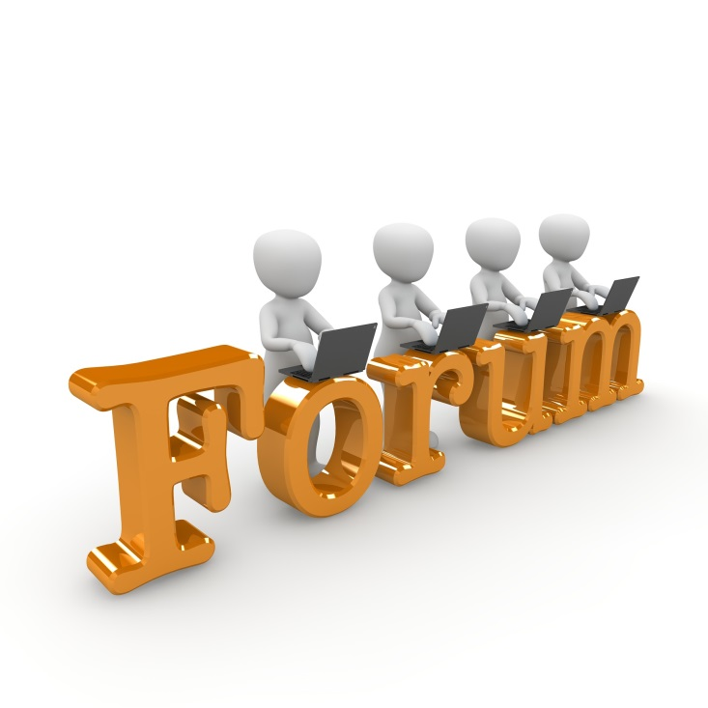
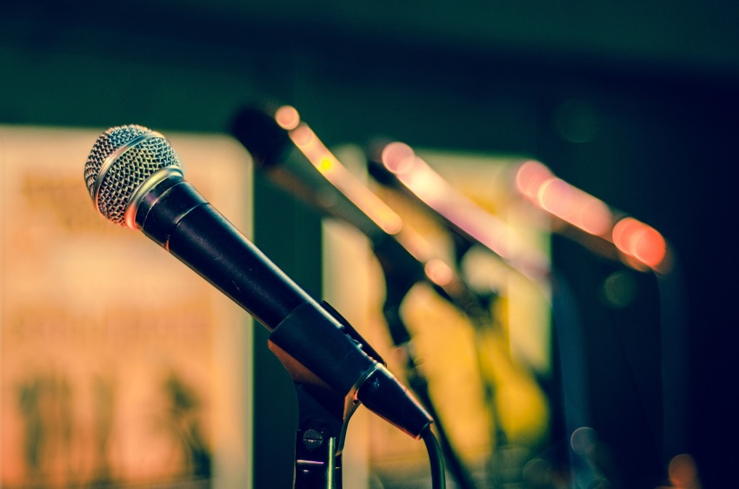
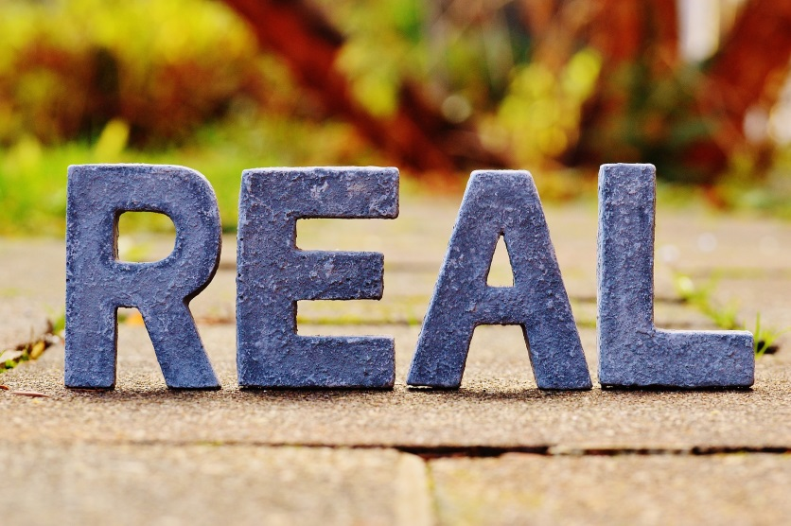
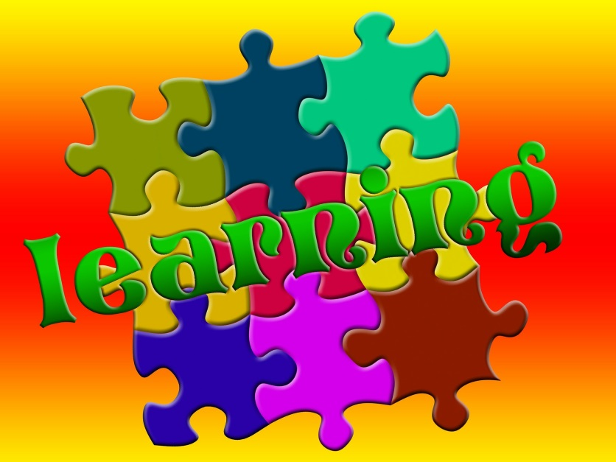

Slide 8
Wiki

Slide 9
Some ways wikis can be used:
for research projects
annotated bibliographies
a glossary of useful terms
a collection of links relevant to the class

Slide 10
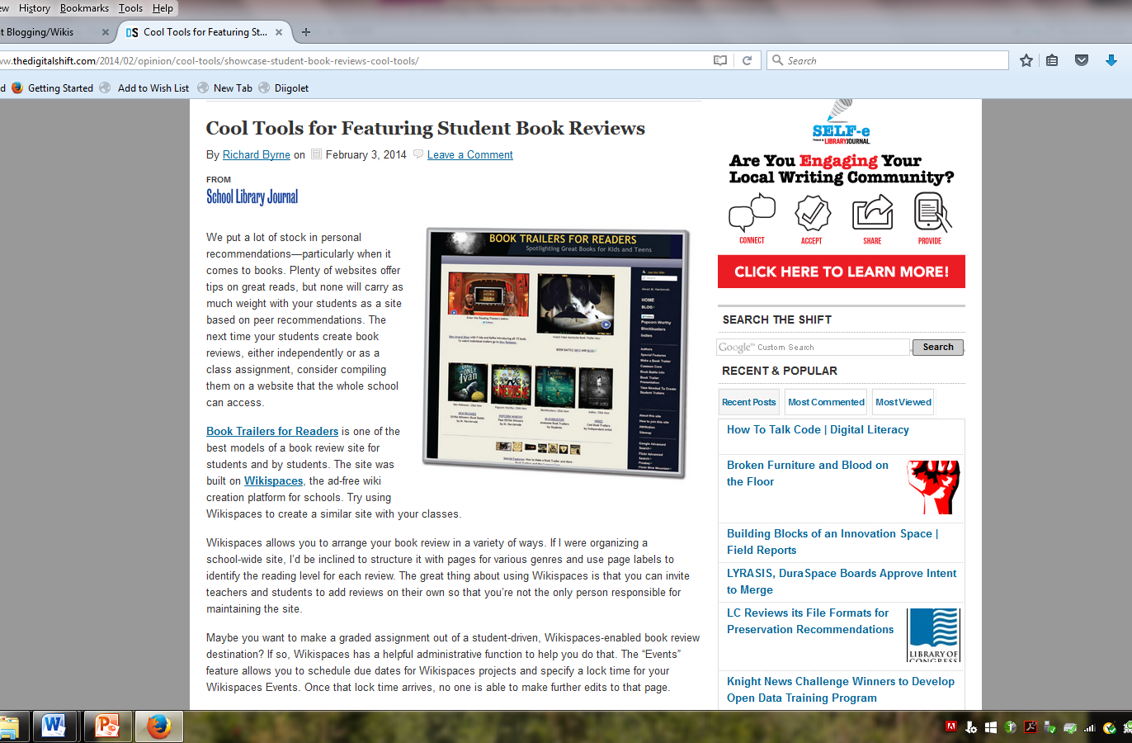

Slide 11
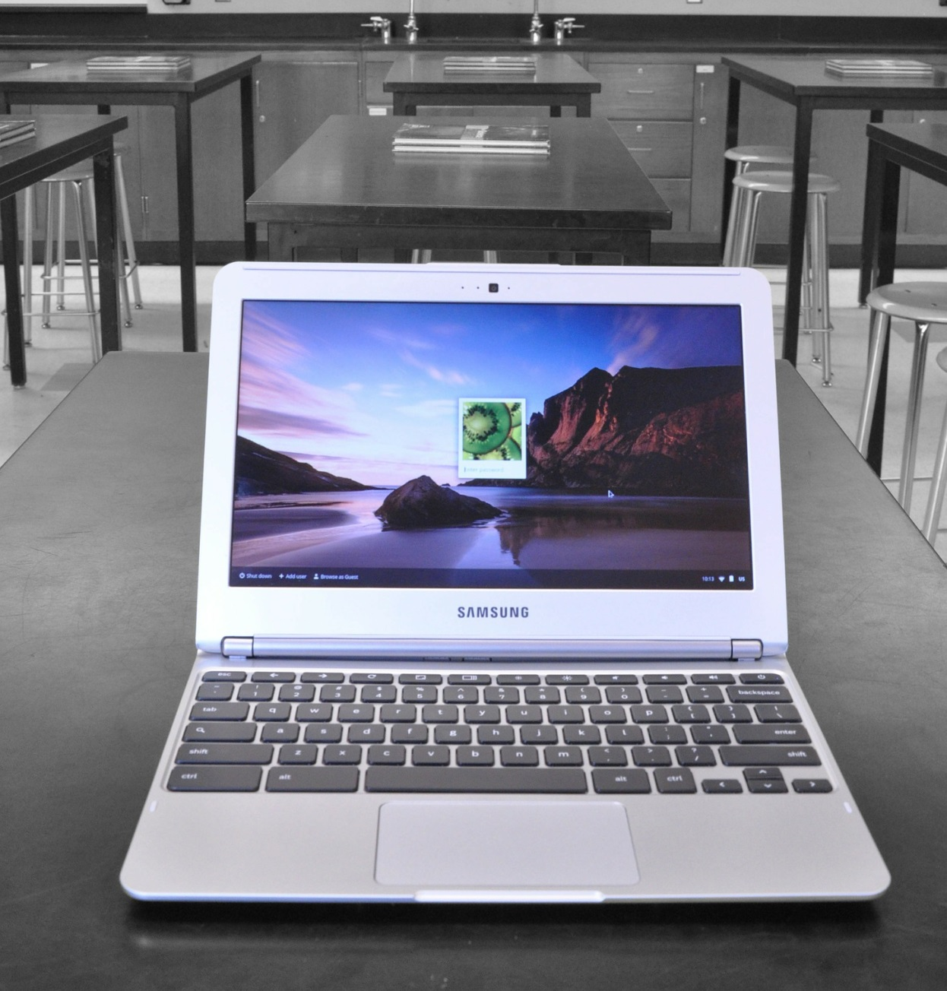

Slide 12
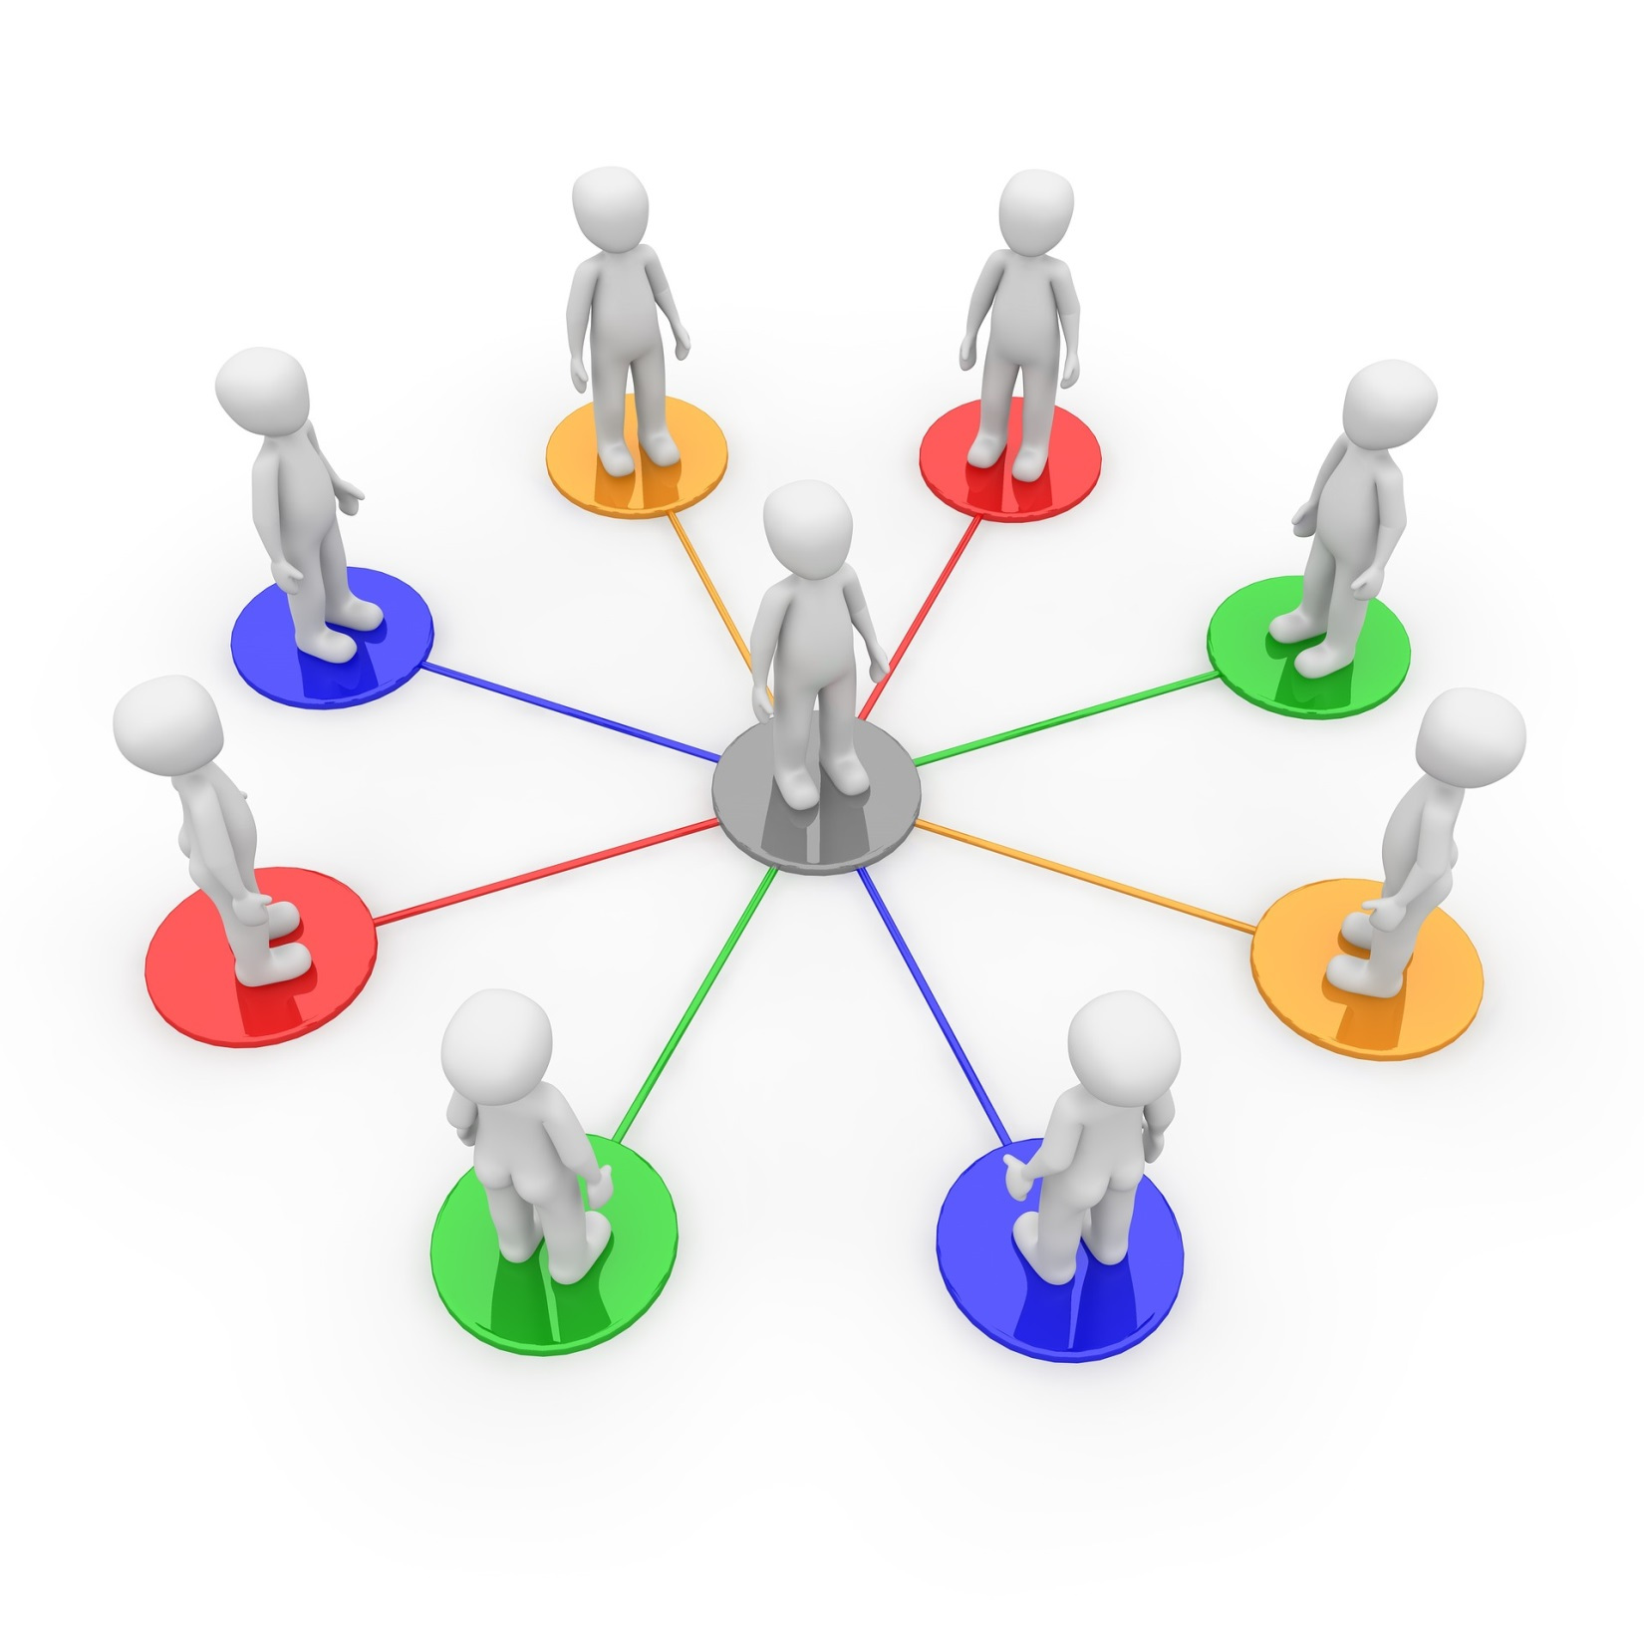

Slide 13
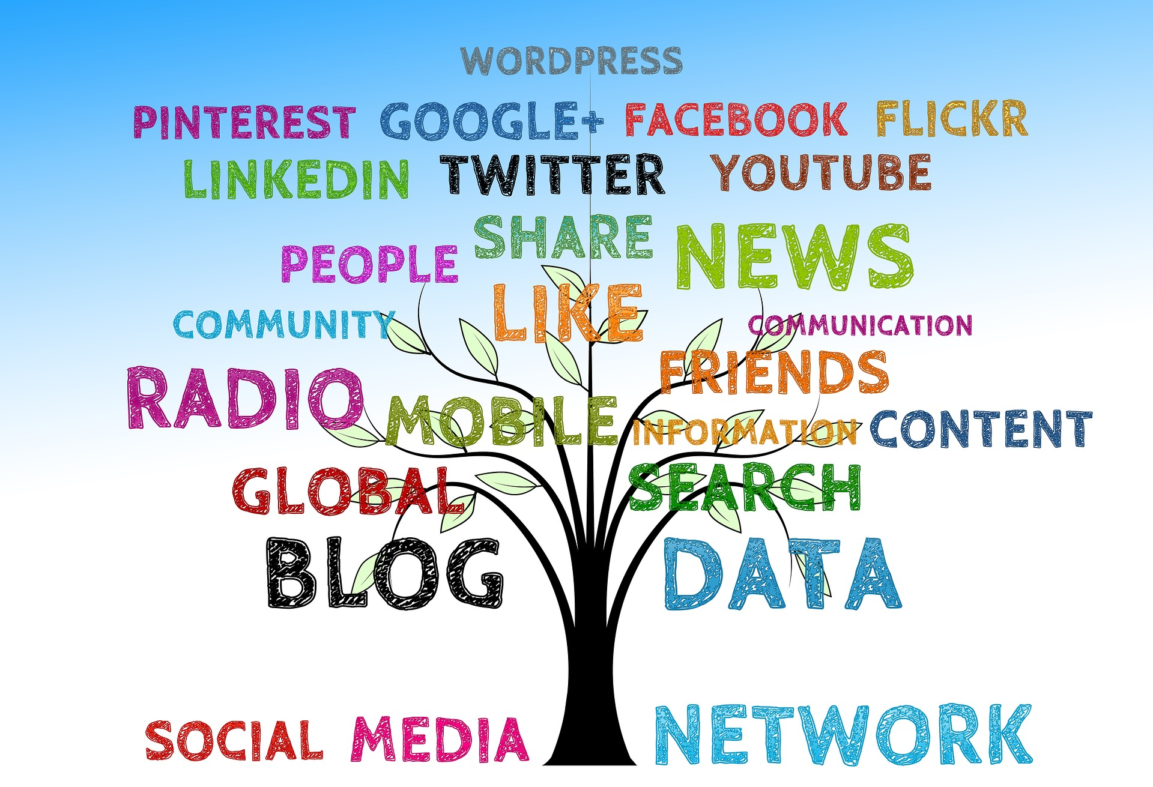

Slide 14
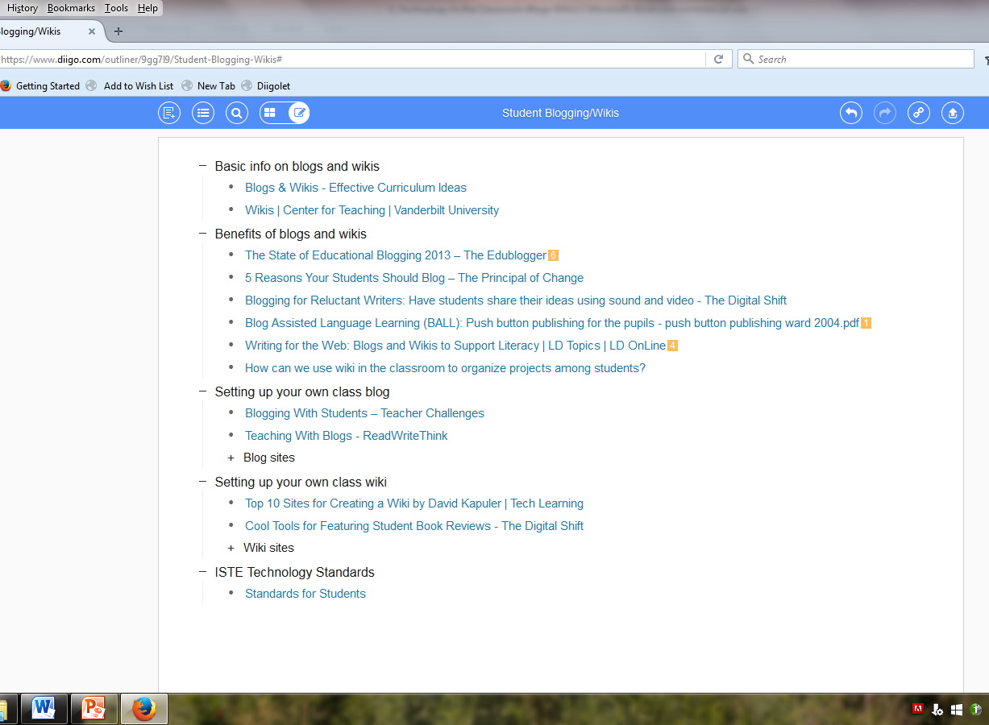

Slide 15
Sources and Works Cited
All images were found on Pixabay (pixabay.com) and are in the public domain.
Baldino, Shannon, and Lisa Fink. "The Classroom Blog: Enhancing Critical Thinking, Substantive Discussion, and Appropriate Online Interaction." Voices From the Middle 22.2 (2014): 29-33. ProQuest Education Journals. Web. 27 Feb. 2016.
Brann, Alise, Tracy Gray, Judy Zorfass, and PowerUp WHATWORKS. "Writing for the Web: Blogs and Wikis to Support Literacy." LD Online. LD Online, 2010. Web. 26 Feb. 2016. <http://www.ldonline.org/article/61329/>.
Byrne, Richard. "Cool Tools for Featuring Student Book Reviews." The Digital Shift. School Library Journal, 03 Feb. 2014. Web. 26 Feb. 2016. <http://www.thedigitalshift.com/2014/02/opinion/cool-tools/showcase-student-book-reviews-cool-tools/>.
"ISTE Standards for Students." ISTE Standards for Students. International Society for Technology in Education, n.d. Web. 26 Feb. 2016. <http://www.iste.org/standards/ISTE-standards/standards-for-students>.
Ward, Jason M. "Blog Assisted Language Learning (BALL): Push Button Publishing for the Pupils." TEFL Web Journal 3.1 (2004): 1-16. 2004. Web. 26 Feb. 2016. <http://www.esp-world.info/Articles_26/push%20button%20publishing%20ward%202004.pdf>.
Waters, Sue. "The State of Educational Blogging 2013." The Edublogger: The State of Educational Blogging 2013. EduBlogs, 08 Aug. 2013. Web. 26 Feb. 2016. <http://www.theedublogger.com/2013/08/08/the-state-of-educational-blogging-2013/>.
"Wikis." Center for Teaching. Vanderbilt University, n.d. Web. 27 Feb. 2016. <https://cft.vanderbilt.edu/guides-sub-pages/wikis/>.

Slide 16
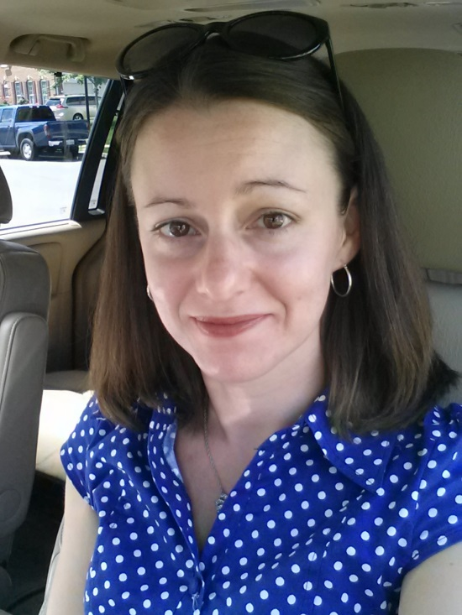
About the Author, Carol Wellen
I am a teacher in Frederick, MD and currently a graduate student at McDaniel College.
You can follow me on Twitter @CarolLWellen.
This Voicethread is licensed under a Creative Commons Attribution-ShareAlike 4.0 International License.

