Slide 1
Staff Inservice
Online tools
Carol Wellen
McDaniel College

Slide 2
Teacher Feedback
PL Survey question:
“What else would you like to learn about?”
Resources for alternative assignments for PE.
Math resources to extend learning
How to integrate the media center with mathematics learning.
How the teenage brain works...

Slide 3
Today’s Objectives
Overview of online resources
Demo of Learn360
Practice with Learn360 (or resource of your choice)

Slide 4
Always start here…

Slide 5
Online resources
New online resources:
FactCite
Learn360
NoodleTools
Continued resource:
Newsela PRO

Slide 6
Newsela Pro
Best for: Current news
What it has: News articles
Additional features:
Adjustable Lexile levels
Premade quizzes available on most articles
Ability to import Google Classroom classes

Slide 7
FactCite
Best for: History resources and Biographies
What it has: Quick Facts, Country facts
Additional features:
Sports biographies
Read aloud feature
Pair with Google translate extension to translate entire pages into Spanish
Articles easily linked to Google classroom
FactCite is very responsive to student/teacher feedback

Slide 8
NoodleTools
Best for: Citations from databases
Replaces: EasyBib
Additional features: Many FCPS databases allow their citations to be exported directly to NoodleTools
Not recommended for: website citations from “Google” research

Slide 9
Learn360
Best for: Multimedia resources and videos
Replaces: Discovery Education
Additional features:
Create playlists for multiple videos
Cut videos into segments
Videos are aligned with CCSS
Ability to search by standard
Videos can be exported to Google Classroom

Slide 10
Ways to use Learn360
https://www.youtube.com/watch?v=IHFlcHHzmZg
Learn360 Testimonials #2 and #3

Slide 11
Learn360 Demo
Login
Search by topic
Filter results
Create a playlist
Use a resource within Google classroom
Search by standard

Slide 12
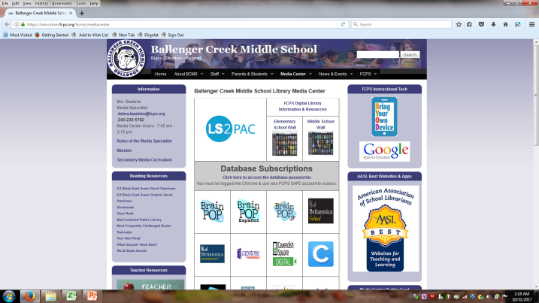
Now… Try it on your own!
Start here:
Things to try:
Searching for a topic
Searching by a content standard
Finding several videos and creating a playlist
Exporting a video to Google classroom for an assignment

Slide 13
Questions/Feedback
Please fill out my Feedback Form when you have a chance. Thank you for your time!

Slide 14
Sources
"Ballenger Creek Middle School Library Media Center." Ballenger Creek Middle School Library Media Center | Ballenger Creek Middle School. Frederick County Public Schools, 09 Sept. 2010. Web.
"FactCite." FactCite. The Lincoln Library, 2017. Web.
Learn360. Infobase, 2017. Web.
Learn360 Testimonial #2. Learn360 Testimonial #2. Learn360, 20 Nov. 2015. Web.
Learn360 Testimonial #3. Learn360 Testimonial #3. Learn360, 20 Nov. 2015. Web.
Newsela | Articles. Newsela, 2017. Web.
"NoodleTools." Noodletools. NoodleTools, 2017. Web.

